Slide 1
Do my grades and my future goal align?

Slide 2
College Means:
When we talk about college, we are talking about any program that provides training after high school that enables students to gain employment that results in a livable wage.
For example:
4 year college, 2 year college, trade school, certificate program, apprenticeship programs

Slide 3

Now see this!
https://youtu.be/zs6nQpVI164
“Success in the New Economy”

Slide 4
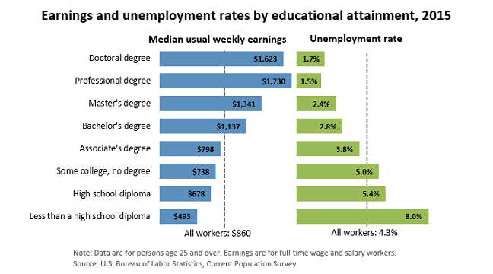
Notes:
Here is an example of what we’re talking about. Notice that the higher your level of education or training after high school, the lower your chances of being unemployed and the greater your potential income is. The above statistics do not separate certificate or trade programs. For info on wage potential for some of the trades see the next slide.

Slide 5
2016 National Average
Data From Bureau of Labor and Statistics
Trade | Average | Top Pay
Aircraft Mechanic | $28.92 | $42.61
Plumber/Pipefitter | $26.49 | $43.13
Electrician | $26.73 | $42.37
Crane Operator | $26.23 | $39.79
Auto Mechanic | $19.59 | $30.45
Brick Mason | $24.88 | $38.85
Commercial Driver | $26.27 | $42.52
CNC Machining | $24.82 | $36.43
HVAC Technician | $22.78 | $34.47
Welder | $19.70 | $28.85

Slide 6
Questions about GPA
What does quality effort mean when thinking about the work you do for class?
What does GPA stand for?
What does a GPA show?
Why is GPA important?

Slide 7
GPA: Grade Point Average
What is it? An average of overall academic performance, usually calculated on a 0-to-4 point scale.
Why does it matter? It’s a very important criteria colleges look at when they decide to accept you, and/or give you scholarship money.
How does it relate to work? Employers will use it to judge your application. How hard you work at school is a good indication of how hard you will work at your job.
If you have a low GPA colleges and employers may think you won’t work hard in college or in a job!
Notes:
You are forming a habit with the effort you put into school and activities outside of school. If you work to make it a good habit (doing your work to the best of your ability and turning it in on time, studying, taking advantages of retakes, seeking tutoring help if needed, budgeting your time, etc) you can be reasonably assured that your good habits will carry over into your life after high school.

Slide 8
Calculating your
GPA
A+ | 4.33
A | 4
A- | 3.67
B+ | 3.33
B | 3
B- | 2.67
C+ | 2.33
C | 2
C- | 1.67
D+ | 1.33
D | 1
D- | 0.8
E | 0
Name of class | Semester Letter Grade | Points (see chart on right)
1.
2.
3.
4.
5.
6.
7.
TOTAL Points | (add up points in right column)
Total points_____/total # of classes_____=_____(this is your GPA)

Slide 9
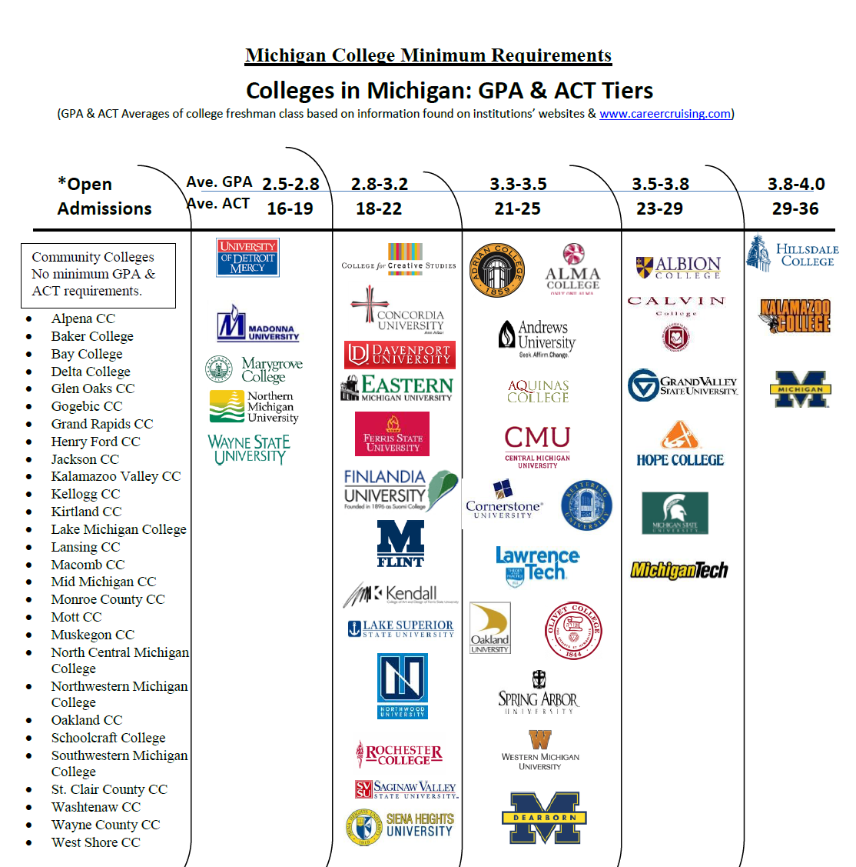

Slide 10
Reflection
What is your current GPA?
Does your current GPA match what is expected at your preferred Michigan college or university?
Are you satisfied with your GPA?
  Why or why not?
Many scholarships and employers look for a GPA of 3.0 or higher. Will you qualify for these scholarships or jobs?
  If yes, what have you done well to reach this accomplishment?
  If no, what can you do to make your GPA higher?
What are you going to do from this point forward to make sure your GPA is as high as it can be?

Slide 11
Beyond GPA
Attendance: be mindful of your time in class. It is hard to succeed when you are playing catch up
Extra-Curricular Activities: Are you trying new clubs/sports/service?
Course Selection: strike a balance with appropriate rigor
Communicate: See your counselor when you have questions or concerns
Visit College Campuses: a great way to start to think about what you are interested in for college

Slide 12
Freshmen Check List
Be a Good Student…that means it is time to learn how to learn. This includes building study skills, research skills, writing (and re-writing), thinking critically and pursuing meaningful independent study.
Involvement in extracurricular activities. Learning occurs outside of the classroom, too. There is no magic combination of clubs and sports. Students are wise to follow their interests – eventually prioritizing depth over breadth
Keep track of activities and achievements. Using Naviance is a great way to do this.

